Slide 1
European Forum For Enhanced
Collaboration in Teaching

Slide 2
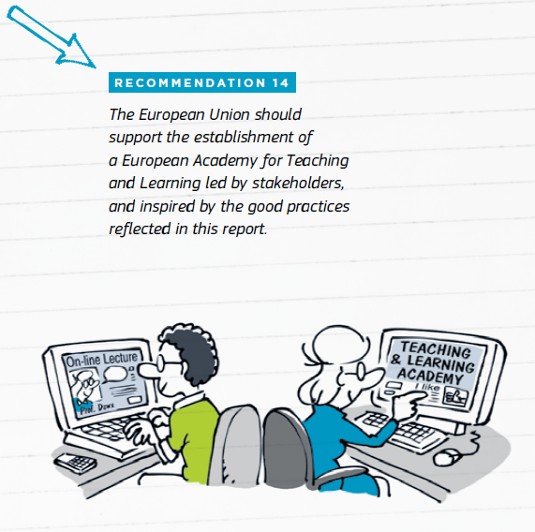
European Forum For Enhanced Collaboration in Teaching
A Forward Looking Cooperation Project (KA3), co-funded by the Erasmus+ Programme of the European Commission
Timeframe: December 2015-November 2018
Led by the European University Association (EUA)
Contact: effect@eua.be
High Level Group report on the Modernisation of Higher Education (2014)
Notes:
2014 - EC High Level Group on the Modernisation of Higher Education – reported on a number of recommendations, including (see pic) “the establishment of a European Academy for Teaching and
Learning led by stakeholders, and inspired by the good practices reflected in this report
EFFECT aims at assessing the feasibility of such a European level structure that would support the enhancement of university teachers, and hence would contribute to enhancing the quality of teaching and
its innovative practice.

Slide 3
Project consortium: partners and friends
Notes:
Partners have been chosen not only regarding their expertise on the topic and broad geographical coverage, but also regarding their role in policy making, and their ability to legitimate a European structure.
They are also complementary in experience, expertise and skills (analysis, practice and policy development).
Project consortium:
learning and teaching experts, practitioners, leadership from higher education institutions,
dedicated organisations and networks and national rectors’ conferences from 10 European countries, namely:
European University Association (project leadership)
European Association for Distance Teaching Universities
The National Unions of Students in Europe
European Trade Union Committee for Education
Irish Universities Association
Conference of Rectors of Academic Schools in Poland
Hungarian Rectors Conference
German Rector’s Conference
University of Latvia
University of Eastern Finland
University Porto
The Higher Education Academy

Slide 4
Objectives
Facilitate exchange and collaboration between European actors for the enhancement of HE teaching
Identify good practices and develop new and innovative approaches
Develop and test new materials for teaching enhancement
Develop a manual of general principles
Support institutions in the development of strategic approaches
Inter-institutional peer-learning on strategic, centralised approaches to teaching enhancement
Develop and test a strategy support package/toolkit
Develop a model for a sustainable European structure
Feasibility study on the mission, activities, target groups, delivery modes, governance and ownership, and business model for self-sustainability
Notes:
Facilitate exchange and collaboration between European actors and stakeholders for the enhancement of higher education teaching (throughout the project)
Bring together expertise of learning and teaching experts, practitioners, leadership from higher education institutions, dedicated organisations and networks and national rectors’ conferences (consortium + external expertise) allowing them to exchange and collaborate on teaching enhancement and function as a professional network
2. Identify good practices and develop new and innovative approaches to learning and teaching enhancement
a systematic and coordinated effort for identifying good practice in teaching enhancement, which is already existent at some institutions and systems, and its sharing and disseminating.
develop new materials based on the focus of how teaching can respond to some of the opportunities and challenges of higher education (see challenges below)
develop a manual of general principles, guidelines and good practice suggestions, bringing together the perspectives of individual teachers, institutions and dedicated networks/ organisations.
propose concrete teaching enhancement materials and methodologies, and deliver and test two pilot modules both through blended learning workshops and online webinars.
The materials will be adapted in accordance to the participant’s feedback and impact assessment and will be published as open educational resources (OER) on the project’s website
3. Support institutions in the development of strategic approaches to the enhancement of learning and teaching
enhancement of teaching in European higher education would also require institutional support - objective under Strand 2 is to inspire institutional leadership to place teaching excellence at the core of their strategic mission, thereby acknowledging the role of teaching in overall student success.
bring together institutional leaders and experts for inter-institutional peer-learning on the development and implementation of strategic, centralised approaches to teaching enhancement.
develop a strategy support package that will be tested at several higher education institutions, adjusted and disseminated as OER on the project website.
4. Develop a model for a sustainable European structure for the enhancement of learning and teaching
develop models and scenarios for a European Forum, which could sustain and expand teaching enhancement, beyond the project duration.
consider mission; activities, target groups and delivery modes; governance and ownership, and a business model for self-sustainability.
transferability to the European and national policy levels (representation and advocacy, active contribution to national and European HE reform) will be important aspects.

Slide 5
Activities & outputs
WG 1 – Teaching Staff Development
Teaching enhancement materials and methodologies;
Pilot modules on Inclusion and Citizenship Skills
WG 2 - Institutional Strategies
Inter-institutional peer-learning on strategy development
Develops and tests a strategy support package
WG 3 – Feasibility study for a European Forum
Looks into the prospects of establishing a European Forum (EFFECT), which would support individual teachers and universities; professional network; basis for advocacy

Slide 6
WG1- Staff development
Overall Mission: contributing to staff development and teaching enhancement
One of the ways for addressing our mission: responding to two of the grand challenges in Higher Education: Inclusion and Citizenship Skills
through
a series of workshops/round tables (both face to face and in a virtual learning environment);
Methodology and modes of delivery:
Hosting round table conversations in different national, European and institutional settings;
Promoting discussions based on a pool of introspective questions;
Involving a wide cross section of relevant stakeholders, including students.

Slide 7
Timeline for workshops on Inclusion and Citizenship Skills
1st workshop (national level), 31 January 2017, University of Porto
2nd workshop (international), March 2017 (tbc), Hungarian Rectors’ Conference, Budapest, Hungary
3rd workshop (national level), August 2017 (tbc), University of Eastern Finland, Kuopio, Finland
4th workshop (international), 27 September 2017, Paris, France
Virtual workshop(s), Autumn 2017-March 2018
Notes:
Please mention: Porto event is therefore very important, as it is the 1st in a series of workshops on Inclusion and Citizenship Skills; furthermore, the outcomes of this workshop and the feedback from participants will feed into the upcoming roundtables, so as to fine-tune the process and ultimately feed into the feasibility study on models for teaching enhancement.
- Via these workshops, 2 models will be indirectly tested, i.e. culturally coherent vs. culturally diverse, in the sense that they could be at a national level, or at a European one. Virtual workshop(s) will be open to European participants.
- The 4th workshop (27 September 2017) will take place back to back with the L&T Forum organised by EUA together with the French National Rectors’ Conference (CPU) and hosted by the University Pierre and Marie Curie (28-29 September).

