Slide 1
"Research-intensive Universities, challenges and dilemmas - an European perspective”
Congress University of Porto
Thinking the Future
October 26, 2016
Fernando Lopes da Silva
Emeritus Professor
Centre of Neuroscience, Swammerdam Institute for Life Sciences, University of Amsterdam, The Netherlands;
Dept. Biomedical Engineering, Instituto Superior Técnico, Universidade de Lisboa, Portugal

Slide 2
Outline
The concept of Research-University and the von Humboldt reform of 1810.
The landscape of Research Universities in Europe: the role of LERU (League of European Research Universities).
A flow-chart of a Research-University.
Research or Graduate Schools.
The Post-doc university career – tenure track-record.
The challenge that research may gradually become detached from teaching.
The challenge of “market—oriented research”.
The puzzles of assessments and the nightmares of rankings.
Pondering about the differences in performance between Universities that belong, and Universities that do not belong to the LERU domain.
What is necessary for a University to reach the Research-intensive” level and eventually to be candidate to LERU membership? Five critical points.

Slide 3
Outline
The concept of Research-University and the von Humboldt reform of 1810.
The landscape of Research Universities in Europe: the role of LERU (League of European Research Universities).
A flow-chart of a Research-University.
Research or Graduate Schools.
The Post-doc university career – tenure track-record.
The challenge that research may gradually become detached from teaching.
The challenge of “market—oriented research”.
The puzzles of assessments and the nightmares of rankings.
Pondering about the differences in performance between Universities that belong, and Universities that do not belong to the LERU domain.
What is necessary for a University to reach the “Research-intensive” level and eventually to be candidate to LERU membership? Five critical points.

Slide 4
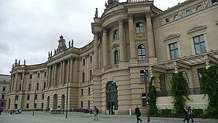
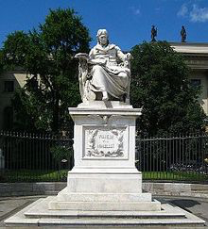
Research Universities
Humboldt University Berlin
The core concept is a holistic combination of
research and learning

Slide 5
Research Universities
The concept of Research-University stems from the reform of Wilhelm von Humboldt at the time of the foundation of the University of Berlin in 1810.
Humboldt’s reform has been a model that strongly influenced other Western universities both in Europe and in North America.
Two key principles of Humboldt’s model are still today building blocks of Universities:
  (a) the union of teaching and research in the work of the individual scholar or scientist, with a heavy assignment of research in a teaching ecosystem;
  (b) the essential role of intellectual freedom in research and teaching.
  “Einsamkeit und Freiheit”.

Slide 6
(a) The union of teaching and research in the work of the individual scholar or scientist
Thus 3 models can be distinguished in the relationship between Research & Teaching (T) in the University:
The strong integrationist model: that stresses the close connection between R & T at the individual level;
The mild integrationist model: that assures the integration of R & T at the institutional or departmental level, but not necessarily at the individual level;
The independence model, claiming no functional relation between T & R.
Discussions about the advantages and disadvantages of these 3 models have prevailed in many publications on the governance of Higher Education.
See for ex: Leisyte, Enders and de Boer. The balance between teaching and research in Dutch and English Universities in the context of University Governance reforms. J. Higher Education 2009.

Slide 7


(b) the essential role of intellectual freedom in research and teaching
The key principle of Humboldt’s model intellectual freedom in research and teaching is anchored in the western philosophical tradition:
Portrait of Erasmus of Rotterdam (1523)
by Hans Holbein the Younger
Baruch Spinoza (1632-1677)
Desiderius Erasmus (1466 – 1536) is a precursor of modern intellectual freedom and a foe of dogmatism.
“The highest activity a human being can attain is learning for understanding, because to understand is to be free”.

Slide 8
Outline
The concept of Research-University and the von Humboldt reform of 1810.
The landscape of Research Universities in Europe: the role of LERU (League of European Research Universities).
A flow-chart of a Research-University.
Research or Graduate Schools.
The Post-doc university career – tenure track-record.
The challenge that research may gradually become detached from teaching.
The challenge of “market—oriented research”.
The puzzles of assessments and the nightmares of rankings.
Pondering about the differences in performance between Universities that belong, and Universities that do not belong to the LERU domain.
What is necessary for a University to reach the Research-intensive” level and eventually to be candidate to LERU membership? Five critical points.

Slide 9
Examples of Research Universities
The landscape of Research Universities in Europe:
the role of LERU(League of European Research Universities)
At the meeting celebrating the 100h anniversary of the American Association of Universities in April 2001 the rectors of four universities (indicated below in red) took the initiative of launching LERU.
The twelve Founding Members of LERU (2002) (alphabetical order) :
University of Cambridge
University of Edinburgh
Université de Genève
Universität Heidelberg
Helsingin yliopisto (University of Helsinki)
Karolinska Institutet (Stockholm) (until 31-3-2011)
Universiteit Leiden
KU Leuven/Louvain
Università degli Studi di Milano
Ludwig-Maximilians Universität München
University of Oxford
Université Louis Pasteur Strasbourg (since 1-1-2009: Université de Strasbourg)
The starting group commissioned an analysis to gauge the research performance of 40 European Universities; in 2002, 12 were admitted as Founding members of LERU
Since 2006 a number of “carefully selected” Universities were invited to join; some other applied or made enquiries about the possibility of becoming members.

Slide 10
Situation in 2016 (now 21) - League of European Research Universities – LERU
Universiteit van Amsterdam (since 2006)
Universitat de Barcelona (since 2010)
University of Cambridge
University of Edinburgh
Albert-Ludwigs-Universität Freiburg (since 2006)
Université de Genève
Universität Heidelberg
Helsingin yliopisto (University of Helsinki)
Universiteit Leiden
KU Leuven/Louvain
Imperial College London (since 2010)
University College London (since 2006)
Lunds universitet (since 2006)
Università degli Studi di Milano
Ludwig-Maximilians-Universität München
University of Oxford
Université Pierre et Marie Curie, Paris (since 2006)
Université Paris-Sud 11 (since 2006)
Université de Strasbourg
Universiteit Utrecht (since 2006)
Universität Zürich (since 2006)
LERU selected its members primarily from the group of
comprehensive, research-intensive universities; top-quality but more specialized institutions, however, were invited if it was felt that their membership could add strategic value to the
organization.
Imperial College London will host LERU's 7th Alumni Chapter on Thursday 27 October 2016.

Slide 11
The landscape of Research Universities in Europe:
Candidates for LERU membership should have a strong research base covering a wide range of fields of knowledge, and sufficiently broad to allow cross-fertilization among various research areas.
Bibliometric analyses play a role in identifying potential members and partners of LERU (as carried out by the Centre for Science and Technology Studies, CWTS at Leiden University). Bibliometric data can yield relevant measures of research performance in given scientific fields, but have to be complemented by other information and used judiciously, but keep always in mind what lies behind the numbers.
Rankings, if properly used and interpreted (what is very often not done), may be indicative of the position of a given scientific field within one University, or among comparable Universities, but at the global level have dubious value, and should better be disregarded. On the issue of “University ranking systems” LERU took the position that it is “absurd to express the quality of such a complicated and diverse organization as a university in a single number”.
It should also be stressed that Bibliometric outputs differ between disciplines. Those in the natural and life sciences publish mostly journal articles; engineers publish journal articles, conference proceedings and patent reports;
social scientists and humanities scholars focus on journal articles, book chapters, essays, monographs and books. Those working in the arts (art, music, dance, drama) and architecture produce creations and artifacts that imply other evaluation approaches.
Not everything that counts can be counted,
and not everything that can be counted counts.
Albert Einstein

Slide 12
Outline
The concept of Research-University and the von Humboldt reform of 1810.
The landscape of Research Universities in Europe: the role of LERU (League of European Research Universities).
A flow-chart of a Research-University.
Research or Graduate Schools.
The Post-doc university career – tenure track-record.
The challenge that research may gradually become detached from teaching.
The challenge of “market—oriented research”.
The puzzles of assessments and the nightmares of rankings.
Pondering about the differences in performance between Universities that belong, and Universities that do not belong to the LERU domain.
What is necessary for a University to reach the Research-intensive” level and eventually to be candidate to LERU membership? Five critical points.

Slide 13
Flow-chart of a Research University
1
Appointments Advisory
Committees
Research or Graduate
Schools
University Staff
2
Assessment
4
Research University
3

Slide 14
Flow-chart of a Research University
Appointments Advisory
Committees
Research or Graduate
Schools
University Staff
Assessment
Research University

Slide 15
Outline
The concept of Research-University and the von Humboldt reform of 1810.
The landscape of Research Universities in Europe: the role of LERU (League of European Research Universities).
A flow-chart of a Research-University.
Research or Graduate Schools.
The Post-doc university career – tenure track-record.
The challenge that research may gradually become detached from teaching.
The challenge of “market—oriented research”.
The puzzles of assessments and the nightmares of rankings.
Pondering about the differences in performance between Universities that belong, and Universities that do not belong to the LERU domain.
What is necessary for a University to reach the Research-intensive” level and eventually to be candidate to LERU membership? Five critical points.

Slide 16
The role of Research, or Graduate, Schools
With respect to Educational issues, LERU published several studies.
Quoting from the last Advice Paper (No 19, March 2016):
“The training of doctoral graduates is at the heart of the mission of research-intensive universities”
How can universities ensure that these objectives will be achieved? They do this by ensuring that they maintain doctoral training embedded in a strong research culture and through Quality Assurance (QA) processes which scrutinize and enhance this culture and activities.
In order to achieve the desired critical mass – both of doctoral students and teaching staff – it is advisable to constitute Networks of Graduate Schools - often involving different Faculties and Universities – to cover adequately a given scientific field of knowledge.

Slide 17
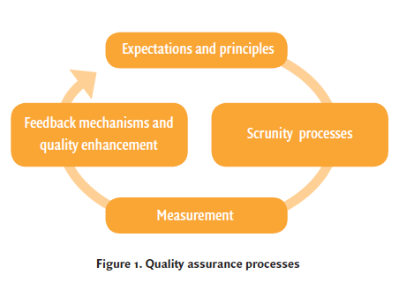
Research training and quality assurance
Quality assurance of research training requires:
1. To define the expectations of all actors (doctoral candidates, supervisors, departments, external partners) and principles of the doctoral program;
2. To set up scrutiny processes to explore the achievements;
3. To measure achievement of key quality indicators;
4. To provide adequate feedback;
A few general PRINCIPLES:
Doctoral candidates should be the drivers of their project, including taking the responsibility of their project;
Programs should be developed in a strong research environment;
Candidates should have the opportunity to cross boundaries of disciplines;
Programs should encourage work contacts outside the University and even outside the country;
Programs should help candidates to make links beyond academia.
Source: Maintaining a quality culture in doctoral education at research-intensive universities. LERU Advice paper
No 19, March 2016.

Slide 18
Flow-chart of a Research University
Appointments Advisory
Committees
Research or Graduate
Schools
University Staff
Assessment
Research University

Slide 19
Outline
The concept of Research-University and the von Humboldt reform of 1810.
The landscape of Research Universities in Europe: the role of LERU (League of European Research Universities).
A flow-chart of a Research-University.
Research or Graduate Schools.
The Post-doc university career – tenure track-record.
The challenge that research may gradually become detached from teaching.
The challenge of “market—oriented research”.
The puzzles of assessments and the nightmares of rankings.
Pondering about the differences in performance between Universities that belong, and Universities that do not belong to the LERU domain.
What is necessary for a University to reach the Research-intensive” level and eventually to be candidate to LERU membership? Five critical points.

Slide 20
The post-doc scientific career
“The key factor for successful research and research-based teaching is to attract the best and most creative minds to the universities and to support them in a nourishing and challenging environment”.
This implies the creation of post-Doc career paths for young academics.
In this respect the concept of Tenure Track (TT) is a “key tool for attracting and keeping the brightest minds at an early career stage in Europe’s Research Universities”.
Tenure track is defined in LERU’s advice paper (No 17, September 2014; “Tenure and tenure track at LERU Universities”) as follows:
a fixed-term contract advertised with the perspective of a permanent position at a higher level,
- This contrasts with ‘probation-on-the-job’ (fixed-term contract with the prospect of a permanent academic position but at the same level) as applied in some Universities.
- Total number of positions available at any level should be flexible. i.e. avoiding bottle-necks in the staff “pyramid”; even better is to have no pyramidal structure.

Slide 21
Outline
The concept of Research-University and the von Humboldt reform of 1810.
The landscape of Research Universities in Europe: the role of LERU (League of European Research Universities).
A flow-chart of a Research-University.
Research or Graduate Schools.
The Post-doc university career – tenure track-record.
The challenge that research may gradually become detached from teaching.
The challenge of “market—oriented research”.
The puzzles of assessments and the nightmares of rankings.
Pondering about the differences in performance between Universities that belong, and Universities that do not belong to the LERU domain.
What is necessary for a University to reach the Research-intensive” level and eventually to be candidate to LERU membership? Five critical points.

Slide 22
Research Universities
University staff is being confronted with a main challenge:
that research may gradually become more detached from teaching.

Slide 23
The “integrationist” that may be called the “conventional wisdom model”
The conclusion of many studies, interviews and assessments is that the integrationist model is the preferable one.
This is called by some “conventional wisdom model”, i.e. teaching and research should be tightly coupled. It is also clear that in this integrated relationship most of the time research is seen as more important for teaching than the other way around.
Nonetheless nearly all academics observe a tendency for political influences to changing the nexus between R & T, by creating “teaching only” staff positions. Accordingly there is a tendency to hire temporary staff to teach.
Thus in many places one can see a weakening of the interrelated unity of R & T in the post-Humboldtian era characterized by differentiating roles and resources for R & T.
This evolution is a matter for concern that needs thorough discussion.
Smeby, J. C. (1998). Knowledge production and knowledge transmission: The interaction between research and teaching at universities. Teaching in Higher Education, 3(1), 7-20.

Slide 24
Outline
The concept of Research-University and the von Humboldt reform of 1810.
The landscape of Research Universities in Europe: the role of LERU (League of European Research Universities).
A flow-chart of a Research-University.
Research or Graduate Schools.
The Post-doc university career – tenure track-record.
The challenge that research may gradually become detached from teaching.
The challenge of “market—oriented research”.
The puzzles of assessments and the nightmares of rankings.
Pondering about the differences in performance between Universities that belong, and Universities that do not belong to the LERU domain.
What is necessary for a University to reach the Research-intensive” level and eventually to be candidate to LERU membership? Five critical points.

Slide 25
Flow-chart of a Research University
Appointments Advisory
Committees
Research or Graduate
Schools
University Staff
Assessment
Research University

Slide 26
The challenge of “market—oriented research”
At the level of the University in general, a challenge being felt in the last decades, is that public funding agents put pressure on Universities to be more intertwined with economic and commercial institutions, stimulating University-Industry technology transfer.
Many of these initiatives seek to spur economic development based on university research, for example, by creating “science parks” located nearby research university campuses, supporting “business incubators” and public “seed capital” funds, and the organization of other forms of “bridging institutions” that are believed to link universities to industrial innovation.
The Bayh-Dole Act of the US (1980) allowed the creation of research partnerships between Universities and Industry with the main objective of more rapidly bringing scientific innovations to the productive line and thus to the market. In this way a sort of “Research-market university“ concept emerged.
The Bayh-Dole Act in the US enabled universities, small companies, and nonprofit organizations to commercialize the results of federally funded research. Before 1981, fewer than 250 patents were issued to universities each year. A decade later universities were averaging approximately 1,000 patents a year.

Slide 27
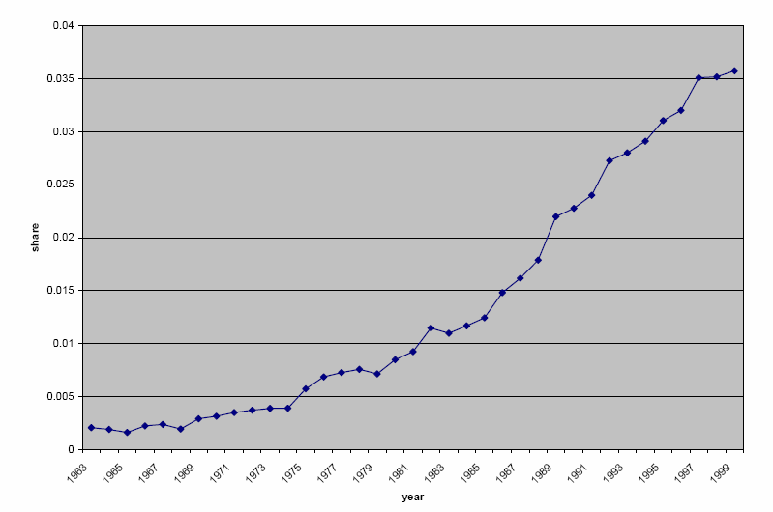
A result of the Bayh-Dole Act
Patents granted to Research Universities in the US as % of all domestic-assignee US patents (source: Bayh-Dale act, PDF)

Slide 28
Should the Bayh-Dole Act be also applied in Europe?
The demands from public funding agents for Universities to be me more intertwined with economic institutions may, apparently, collide with the principle of the “Magna Carta of European Universities” of the Bologna Declaration (1988) that:
“'research and teaching must be morally and intellectually independent of all political authority and economic power”.
A number of European countries have taken measures or have been considering to adopt policies emulating some of the Act’s provisions, but in different ways:
while some have followed the trend for universities to claim ownership over academic inventions (UK),
others passed legislation to shift ownership from University to individual researchers (Italy).
This issue has to be carefully discussed at the academic and political levels, and the pros and cons adequately weighted.
Mowery, DC. Learning from one another? International policy “emulations” and University-Industry technology transfer. Industrial and corporate Change 2011: 1827-18530.

Slide 29
Outline
The concept of Research-University and the von Humboldt reform of 1810.
The landscape of Research Universities in Europe: the role of LERU (League of European Research Universities).
A flow-chart of a Research-University.
Research or Graduate Schools.
The Post-doc university career – tenure track-record.
The challenge that research may gradually become detached from teaching.
The challenge of “market—oriented research”.
The puzzles of assessments and the nightmares of rankings.
Pondering about the differences in performance between Universities that belong, and Universities that do not belong to the LERU domain.
What is necessary for a University to reach the Research-intensive” level and eventually to be candidate to LERU membership? Five critical points.

Slide 30
Flow-chart of a Research University
Appointments Advisory
Committees
Research or Graduate
Schools
University Staff
Assessment
Research University

Slide 31
The puzzles of assessments and the nightmares of rankings
The rationale for assessment within a university can be summarized as follows:
• rigorously gauge research output, quality and impact, thus ensuring future allocation of funds,
improving performance.
• provide the academic community with an opportunity to receive international peer feedback enabling identification of strengths and weaknesses;
• recruit, retain and reward top performers; identify and track individual accomplishments;
• track (and possibly reward) departments/faculties for exceptional
performance and leadership;
• find and foster productive collaborations, including international ones;
Thus: The main foundations of the assessment methodology are:
Peer review, if conflicts of interest are prevented;
Bibliometrics, if correctly interpreted;
Impact and reputation among peers and scientific community, if the process of gathering information is properly carried out;
In short: assessment implies a lot of COMMON SENSE and avoiding being mesmerized by rankings.

Slide 32
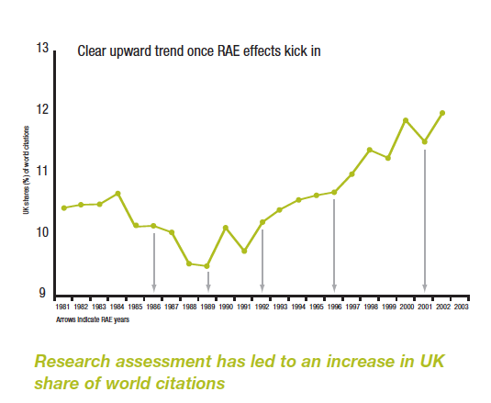
Influence of the Research Assessment Exercise (RAE) of 1986 (now: Research Excellence Framework (REF)) in the UK.
Source: Higher Education Funding Council for England, www.hefce.ac.uk; in: LERU Position Paper: Research universities and research assessment. May 2012.

Slide 33
Flow-chart of a Research University
Appointments Advisory
Committees
Research or Graduate
Schools
University Staff
Assessment
Research University

Slide 34
Outline
The concept of Research-University and the von Humboldt reform of 1810.
The landscape of Research Universities in Europe: the role of LERU (League of European Research Universities).
A flow-chart of a Research-University.
Research or Graduate Schools.
The Post-doc university career – tenure track-record.
The challenge that research may gradually become detached from teaching.
The challenge of “market—oriented research”.
The puzzles of assessments and the nightmares of rankings.
Pondering about the differences in performance between Universities that belong, and Universities that do not belong to the LERU domain.
What is necessary for a University to reach the Research-intensive” level and eventually to be candidate to LERU membership? Five critical points.

Slide 35
What is necessary for a University to reach the Research-intensive” level and eventually to be accepted as LERU member?
Since we are at the University of Porto, I assume that it would be appropriate to focus on some examples from Portugal.
To define a strategy with this objective it is useful to ponder about the differences in performance between Universities that belong, and Universities that do not belong to the LERU domain.

Slide 36
University | Nr Students (Nr staff) | Student /Staff Ratio | Nr Publications (total)(2011-14) | Nr Publications/staff (2011-14) | PP (top 10%) | MNCS
Aveiro | 10.791 (606) | 17.8 | 2814 | 4.6 | 9.2% | 0.96
Coimbra | 22.795 (1199) | 19 | 2926 | 2.4 | 8.6% | 0.90
Lisbon | 18.867 (1978) | 17.5 | 6213 | 3.1 | 8.8% | 0.94
Porto | 32.720 (1740) | 18.8 | 5377 | 3.1 | 9.1% | 0.94
Minho | 19.090 (1015) | 18.8 | 1976 | 1.9 | 8.8% | 0.96
Amsterdam | 24.570 (1706) | 14.4 | 8248 | 4.8 | 14.3% | 1.26
Imperial College London | 15.060 (1287) | 11.7 | 10791 | 8.3 | 16.1% | 1.39
Oxford | 19.919 (1717) | 11.6 | 13300 | 7.7 | 18.1% | 1.53
Key statistics according to the data of the Times Higher Education Assessment 2016.
Research performance, estimated by means of bibliometric indicators based exclusively on data from the Web of Science database (Source: CWTS, Leiden).
Two “critical indicators"
- PP (top 10%)– Proportion of publications belonging to the top 10% of the corresponding scientific fields;
- MNCS – Mean normalized citation score; normalized for the specific patterns of publication in different scientific fields, and publication year.

Slide 37
Outline
The concept of Research-University and the von Humboldt reform of 1810.
The landscape of Research Universities in Europe: the role of LERU (League of European Research Universities).
A flow-chart of a Research-University.
Research or Graduate Schools.
The Post-doc university career – tenure track-record.
The challenge that research may gradually become detached from teaching.
The challenge of “market—oriented research”.
The puzzles of assessments and the nightmares of rankings.
Pondering about the differences in performance between Universities that belong, and Universities that do not belong to the LERU domain.
What is necessary for a University to reach the Research-intensive” level and eventually to be candidate to LERU membership? Five critical points.

Slide 38
What is necessary for a University to reach the Research-intensive” level and eventually to be candidate to LERU membership? Five critical points:
A basic requirement for high level researcher training is to place training programs in research environment of outstanding quality. This can best be achieved in Research (Graduate) Schools with appropriate accreditation, and preferably within the framework of interuniversity collaborations, and with sufficient critical mass;
To apply demanding selection procedures for the appointment of staff members based on strong scientific performance of individuals and acknowledged teaching expertise.
To establish flexible post-doc and tenure track careers, based on individual capacities in research & teaching, avoiding “inbreeding".
To concentrate resources in research fields having the potential of achieving recognized international leadership, creating environments where people can actively engage in exploring novel ideas even if these may appear as “outliers”.
To apply multifactorial systems of research financing, including those emerging from University-Industry interactions (patent licensing, ”spin-offs”, contract research, informational outputs), but keeping high standards of intellectual freedom.

Slide 39
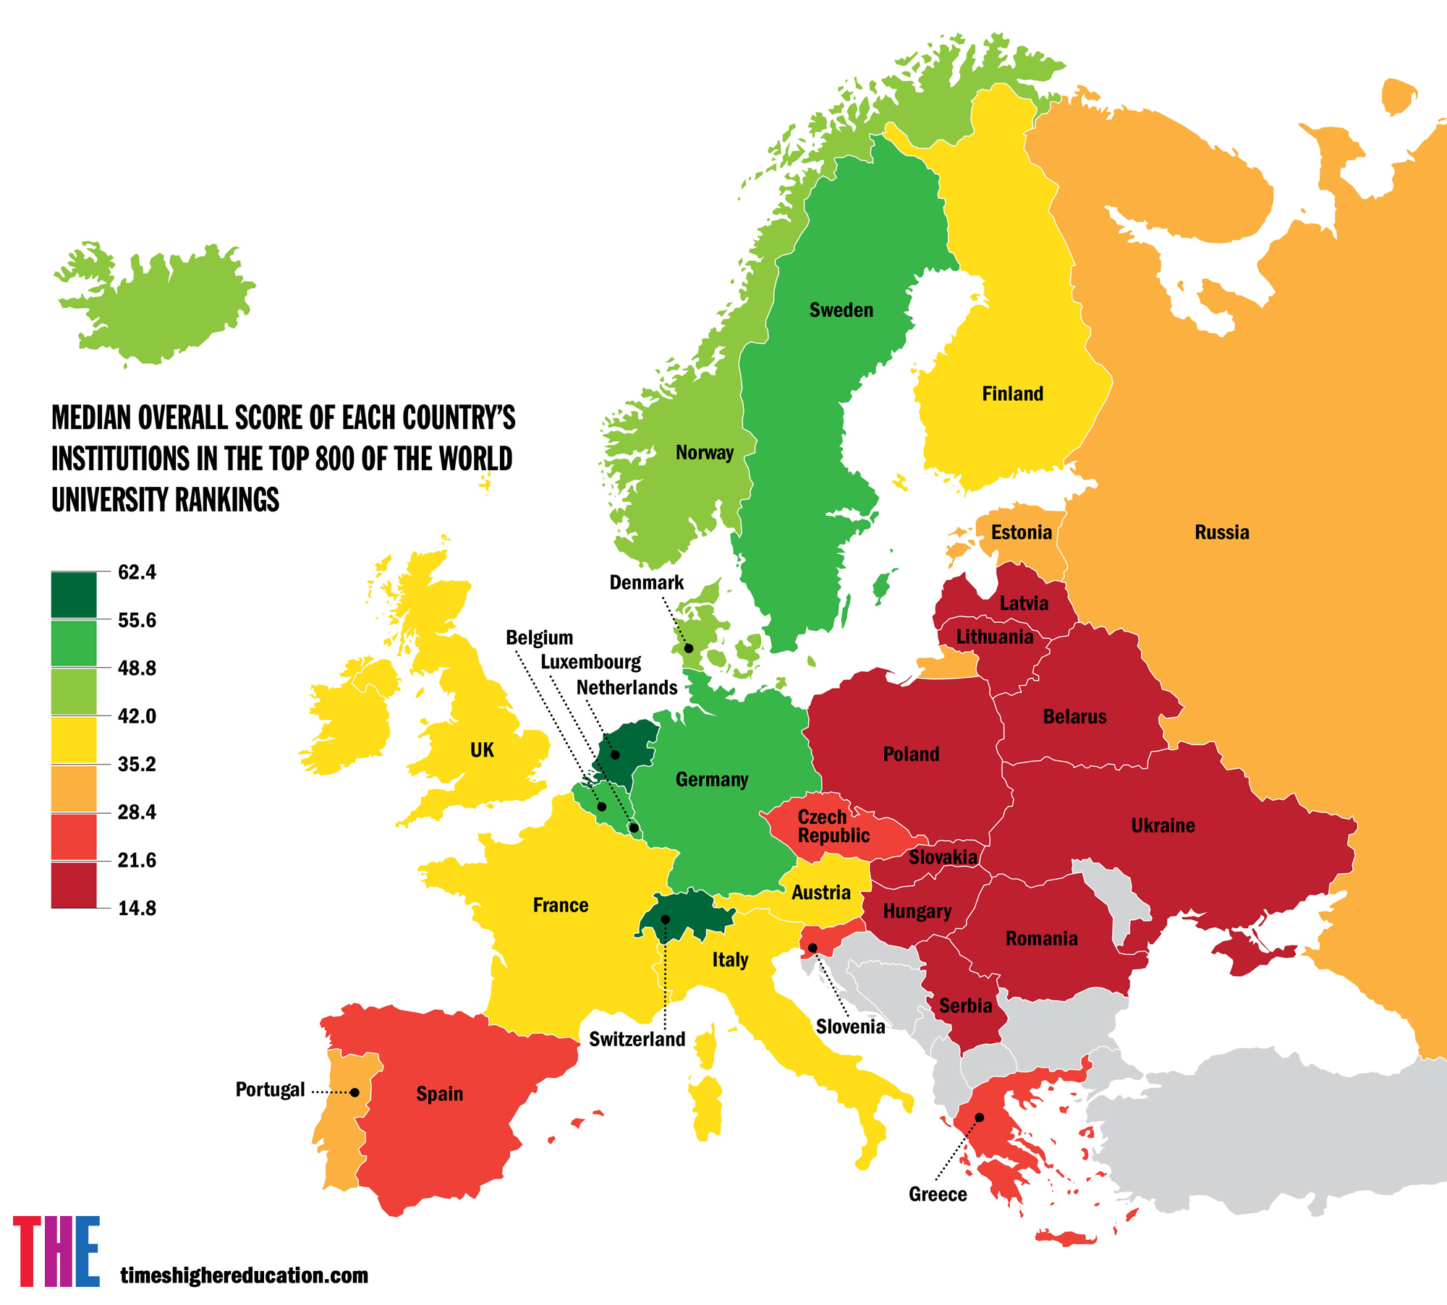

Slide 40
Outline
The concept of Research-University and the Humboldt reform of 1810.
The landscape of Research Universities in Europe: the role of LERU (League of European Research Universities).
A flow-chart of a Research-University.
Research or Graduate Schools.
The Post-doc university career – tenure track-record.
The challenge that research may gradually become detached from teaching.
The challenge of “market—oriented research”.
The puzzles of assessments and the nightmares of rankings.
Pondering about the differences in performance between Universities that belong, and Universities that do not belong to the LERU domain.
What is necessary for a University to reach the Research-intensive” level and eventually to be candidate to LERU membership? Five critical points.

